Slide 1
Object Oriented Programming—C++ Lecture2 Types and Structs
QiJun Zhao

Slide 2
Today
- Quick Recap
- Types
- Intro to structs

Slide 3
C++: Basic Syntax + the STL
Basic syntax
- Semicolons at EOL
- Primitive types (ints,doubles etc)
- Basic grammar rules
The STL
- Tons of general functionality
- Built in classes like maps, sets, vectors
- Accessed through the namespace std::

Slide 4
C++: Basic Syntax + the STL
The STL
- Tons of general functionality
- Built in classes like maps, sets, vectors
- Accessed through the namespace std::
- Extremely powerful and well-maintained
Basic syntax
- Semicolons at EOL
- Primitive types (ints,doubles etc)
- Basic grammar rules

Slide 5
Namespaces
● MANY things are in the std:: namespace
○ e.g. std::cout, std::cin, std::lower_bound
● CS 106B always uses the using namespace std;
declaration, which automatically adds std:: for you
● We won’t (most of the time)
○ it’s not good style!

Slide 6
A note about STL naming conventions
- STL = Standard Template Library
- Contains TONS of functionality (algorithms, containers, functions, iterators) some of which we will explore in this class
- The namespace for the STL is std
- std is the abbreviation for standard
- IDK why they didn’t name the namespace stl
- So to access elements from the STL use std::

Slide 7
Today
- Quick Recap
- Types
- Intro to structs

Slide 8
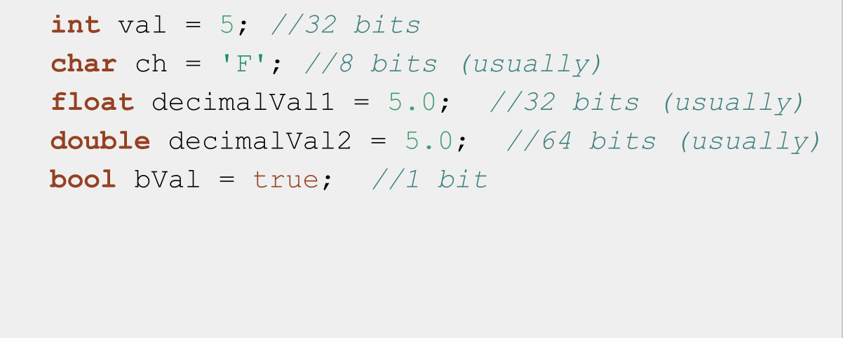
C++ Fundamental Types

Slide 9
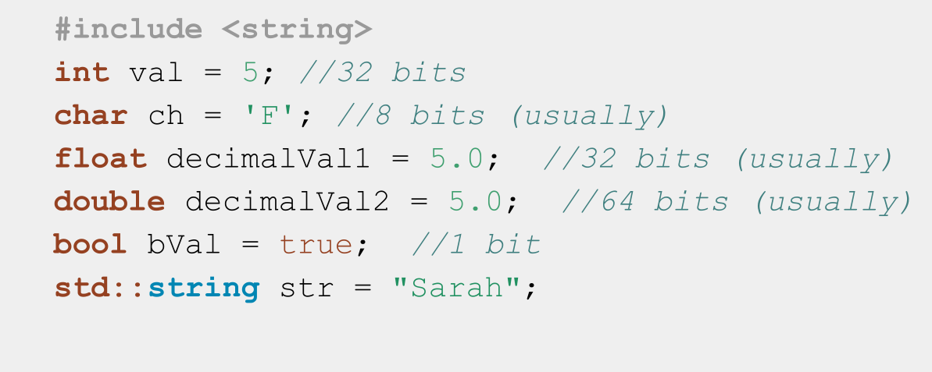
C++ Fundamental Types++

Slide 10
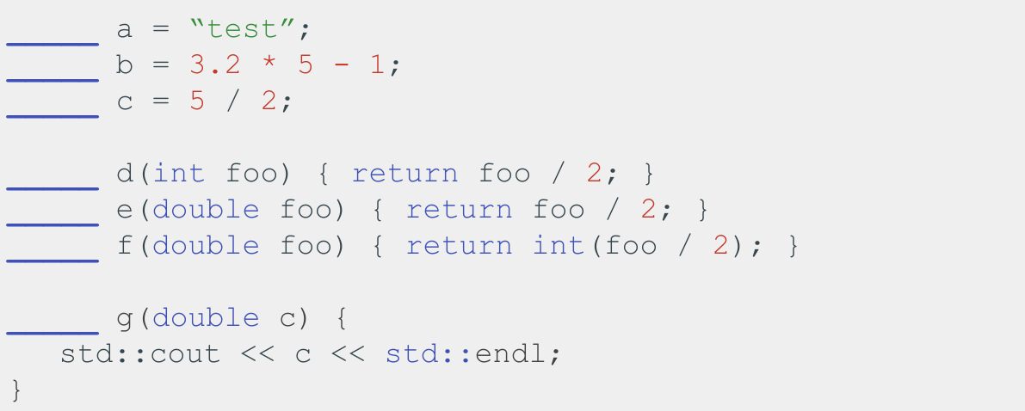
Fill in the types!

Slide 11
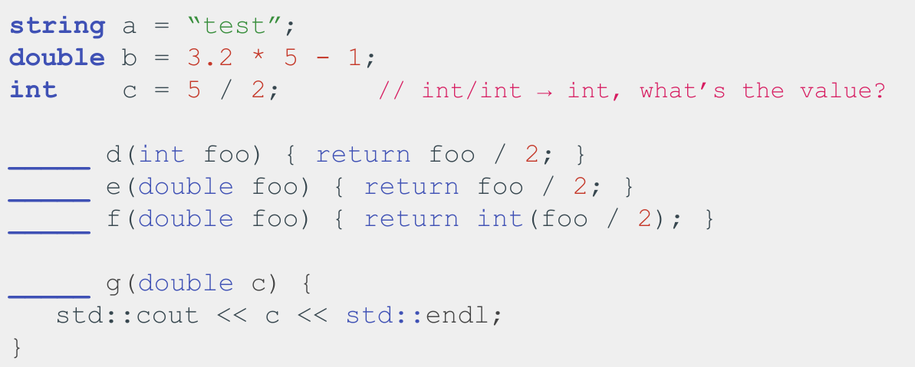
Fill in the types!

Slide 12
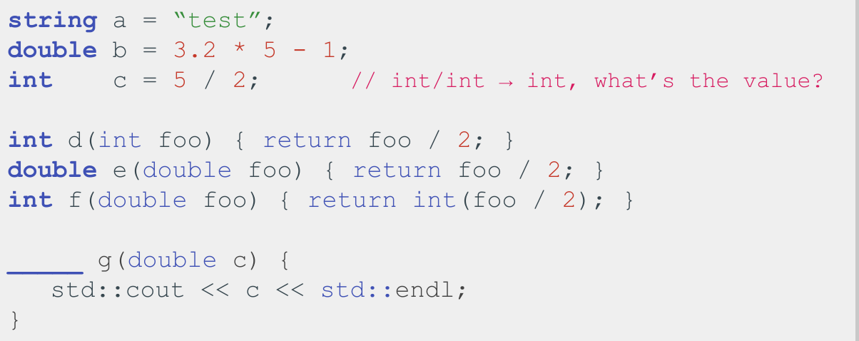
Fill in the types!

Slide 13
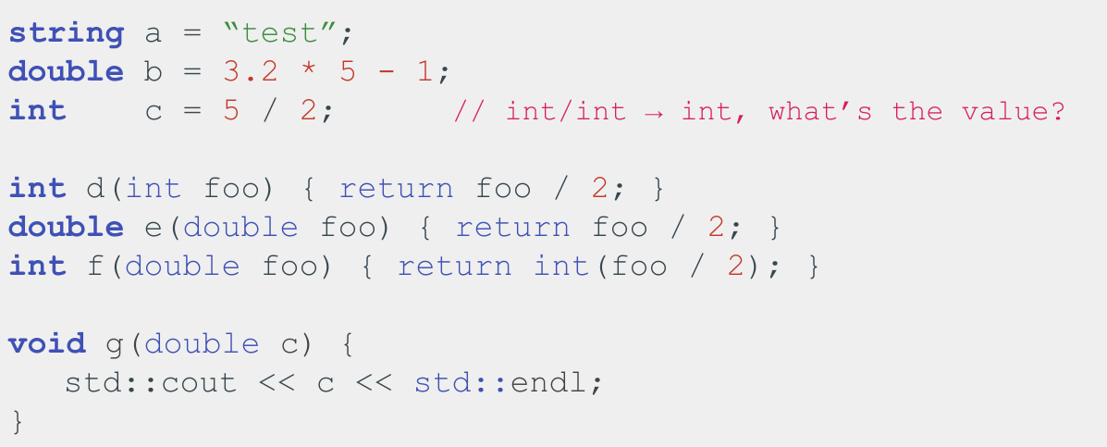

Slide 14
C++ is a statically typed language
Statically typed: everything with a name (variables, functions, etc) is given a type before runtime
Dynamically typed:everything with a name (variables, functions, etc) is given a type at runtime based on the thing’s current value

Slide 15
Translated: Converting source code into something a computer can understand (i.e. machine code)
Compiled vs Interpreted
Main Difference: When is source code translated?
Source Code: Original code,
usually typed by a human into a
computer (like C++ or Python)

Slide 16
Compiled vs Interpreted: When is source code translated?
Dynamically typed, interpreted
- Types checked on the fly, during
execution, line by line
- Example: Python
Statically typed, compiled
- Types before program runs
during compilation
- Example: C++
Runtime: Period when program is executing commands (after compilation, if ompiled)

Slide 17
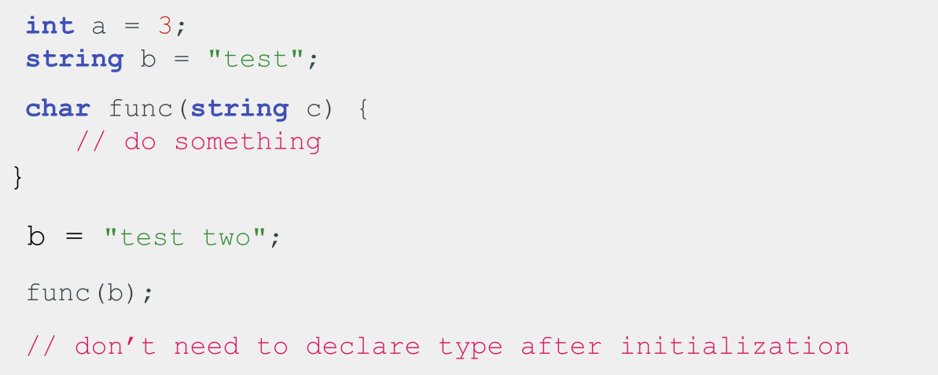
C++ Types in Action

Slide 18
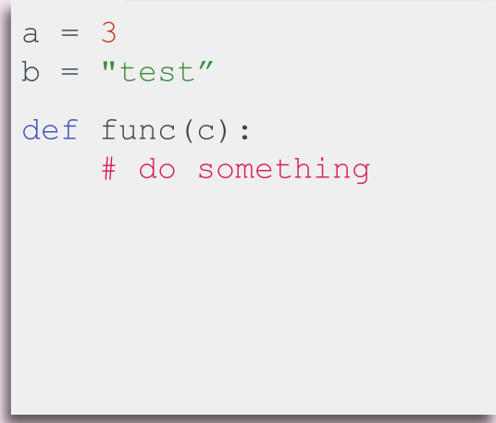
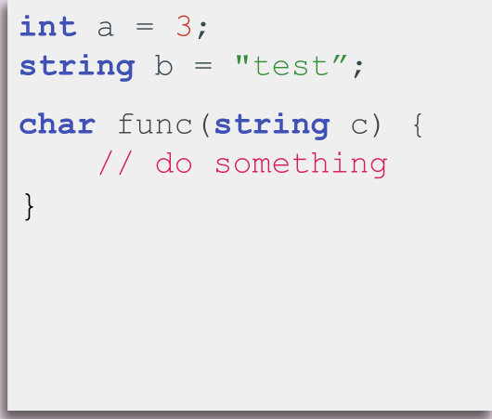
Dynamic vs Static typing: Python vs C++
Python
C++

Slide 19
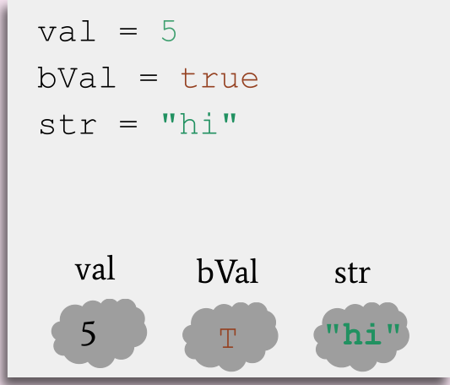
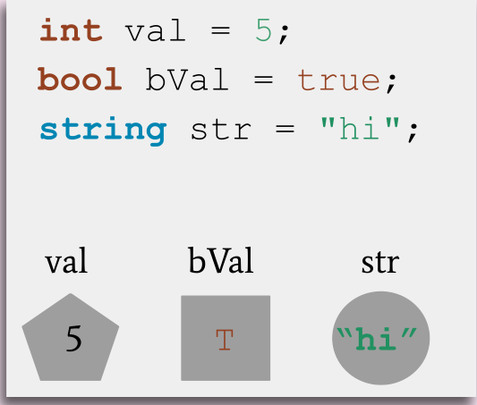
Dynamic vs Static typing: Python vs C++
Python
C++

Slide 20
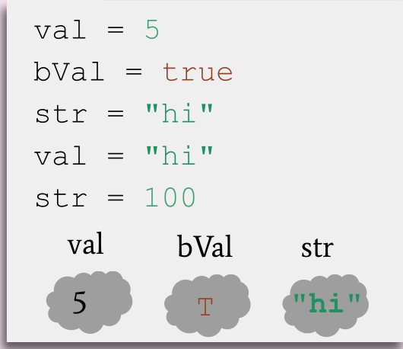
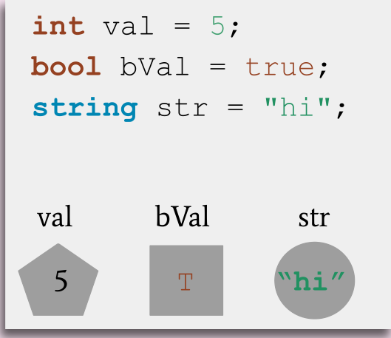
Dynamic vs Static typing: Python vs C++
Python
C++

Slide 21
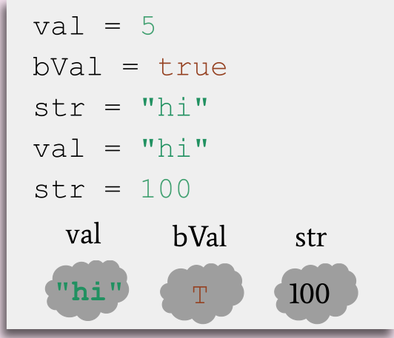
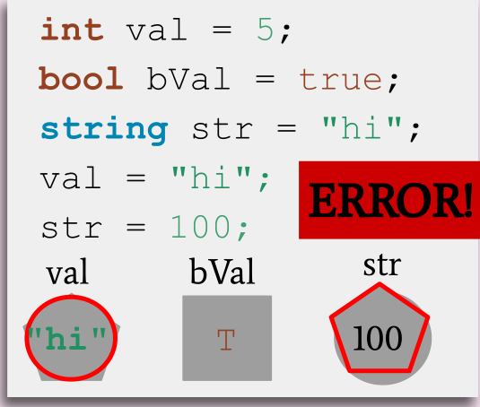
Dynamic vs Static typing: Python vs C++
Python
C++

Slide 22
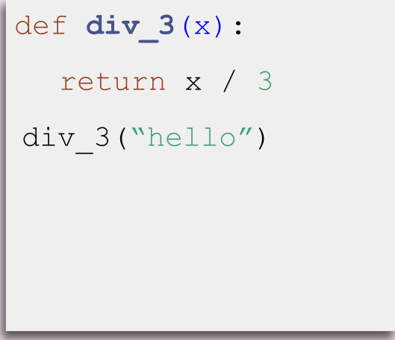
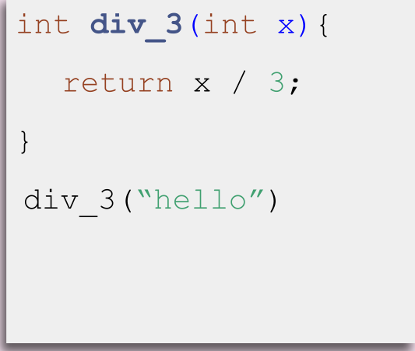
Dynamic vs Static typing: Python vs C++
Python
C++

Slide 23
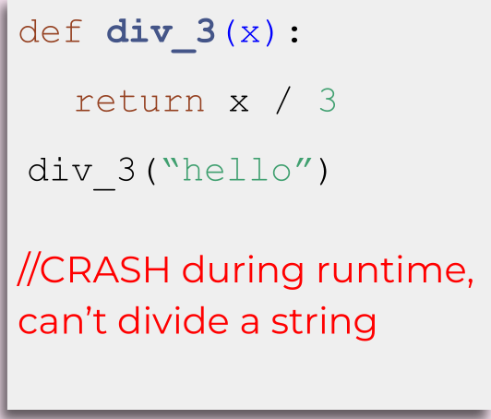
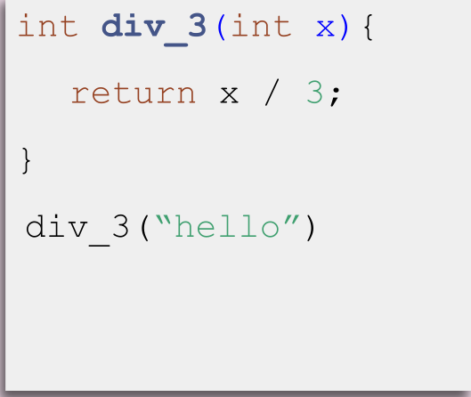
Dynamic vs Static typing: Python vs C++
Python
C++

Slide 24

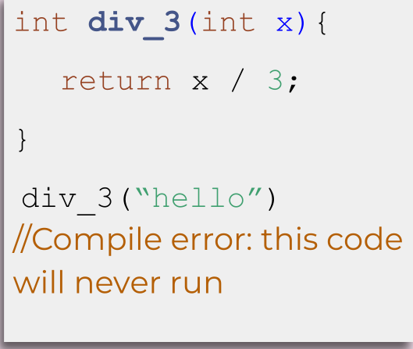
Dynamic vs Static typing: Python vs C++
Python
C++

Slide 25
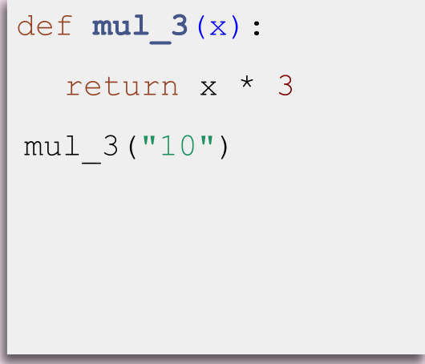
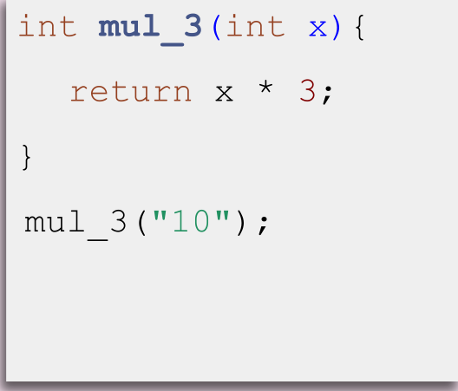
Dynamic vs Static typing: Python vs C++
Python
C++

Slide 26
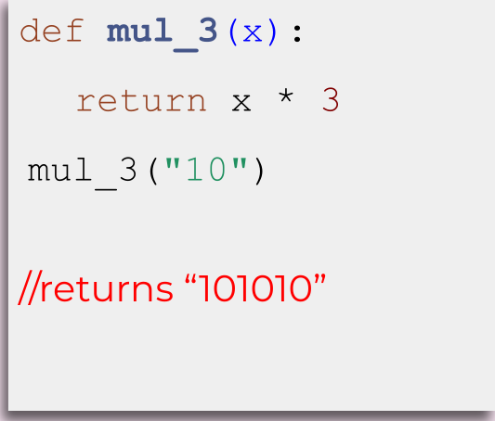
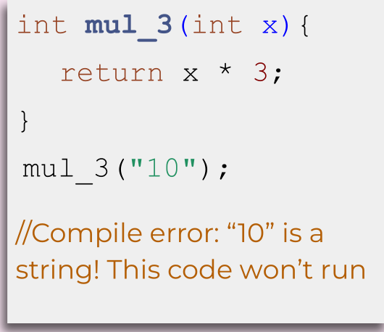
Dynamic vs Static typing: Python vs C++
Python
C++

Slide 27
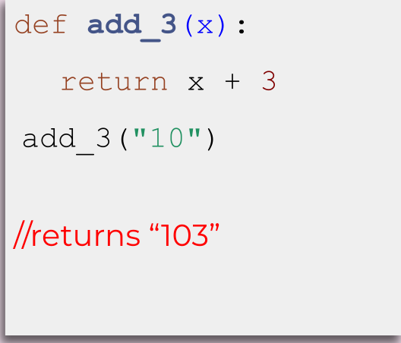
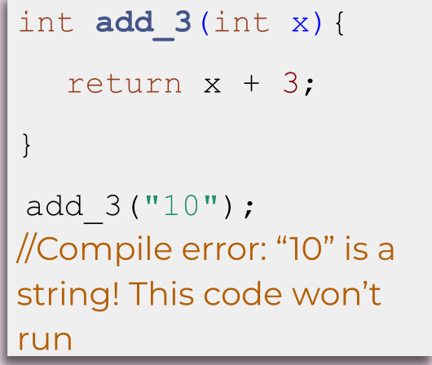
Dynamic vs Static typing: Python vs C++
Python
C++

Slide 28
static typing helps us to
prevent errors before our
code runs

Slide 29


Static Types + Functions
Python
C++
def div_3(x)
div_3: __ -> ??
int div_3(int x)
div_3: int -> int

Slide 30
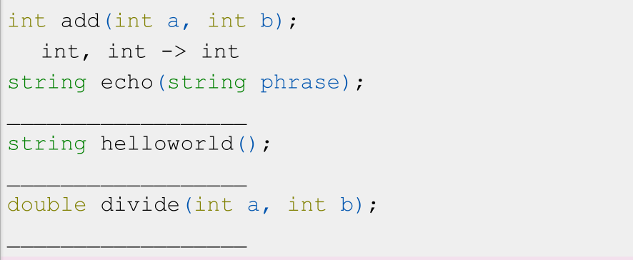
Static Types + Functions
What are the “types” of the following functions?

Slide 31
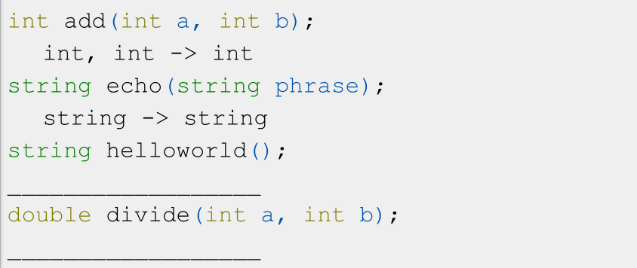
Static Types + Functions
What are the “types” of the following functions?

Slide 32
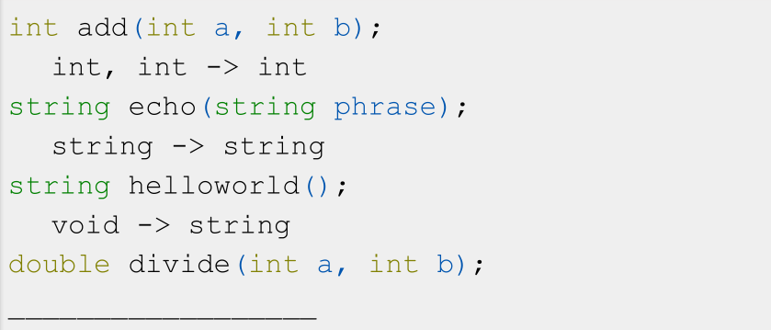
Static Types + Functions
What are the “types” of the following functions?

Slide 33
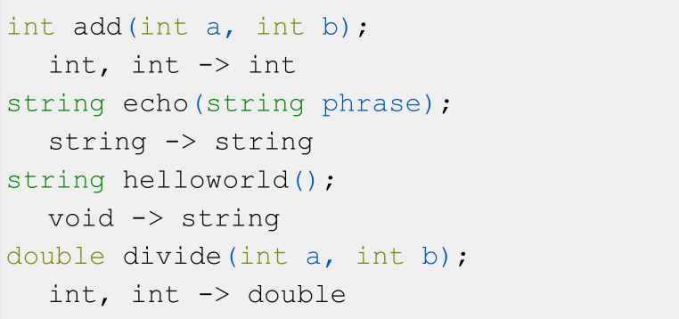
Static Types + Functions
What are the “types” of the following functions?

Slide 34
Overloading
- What if we want two versions of a function for
two different types?
- Example: int division vs double division

Slide 35
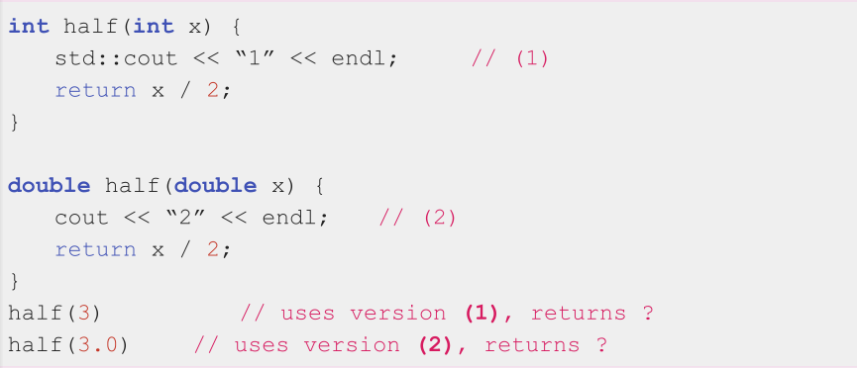
Overloading
Define two functions with the same name but different types

Slide 36

Overloading
Define two functions with the same name but different types

Slide 37
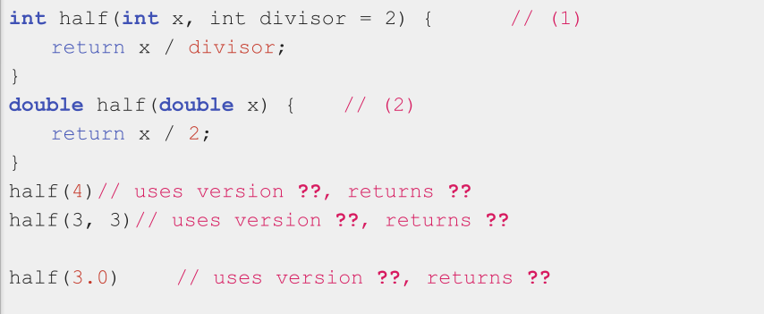
Overloading
Define two functions with the same name but different types

Slide 38
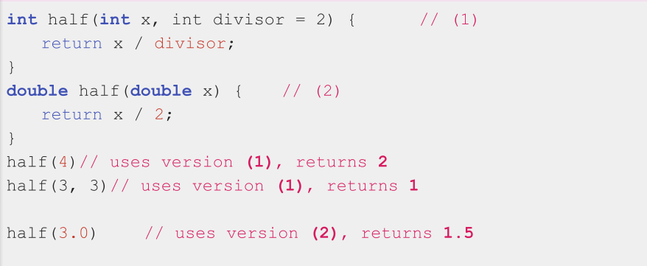
Overloading
Define two functions with the same name but different types

Slide 39
Today
- Quick Recap
- Types
- Intro to structs

Slide 40
Definition
Struct: a group of named variables each with their own type. A way to bundle different types together

Slide 41
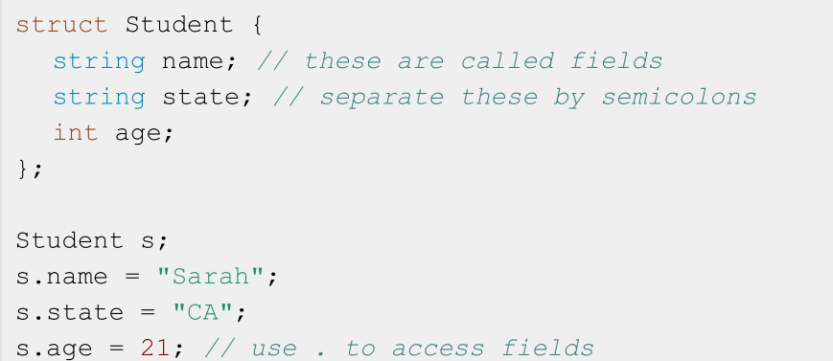
Structs in Code

Slide 42
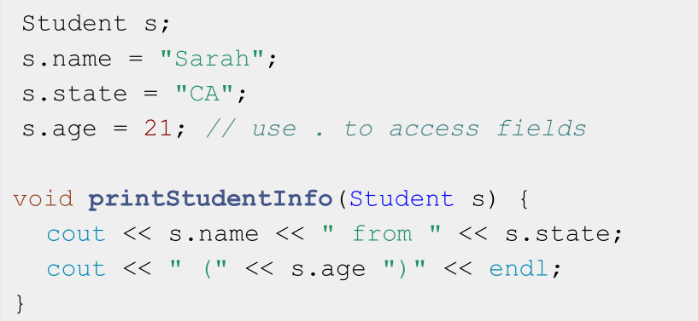
Use structs to pass around grouped information

Slide 43
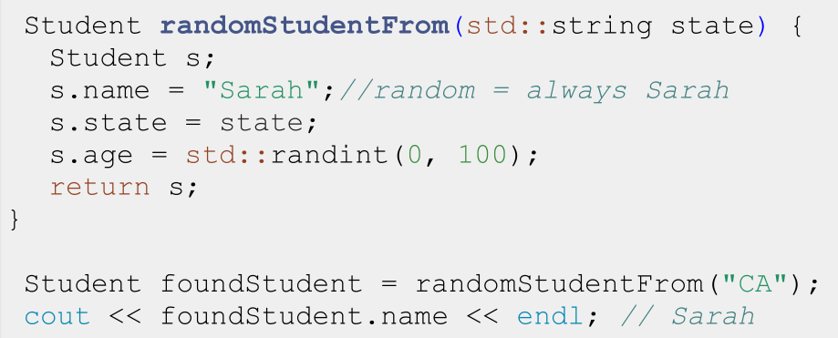
Use structs to return grouped information

Slide 44
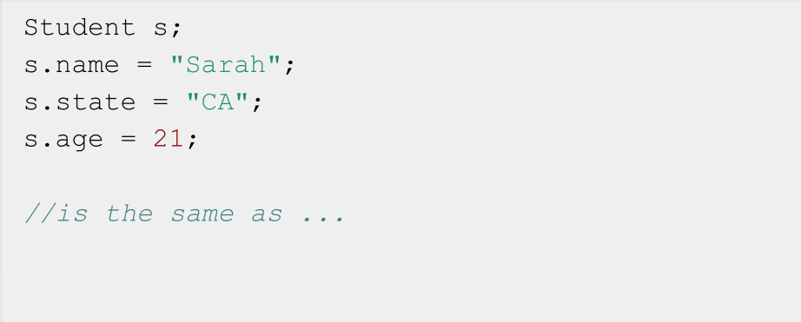
Abbreviated Syntax to Initialize a struct

Slide 45
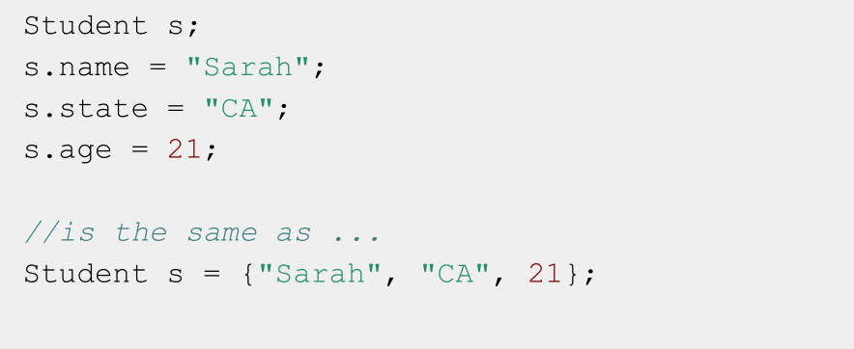
Abbreviated Syntax to Initialize a struct

Slide 46
Definition
std::pair: An STL built-in struct with two fields of any type

Slide 47
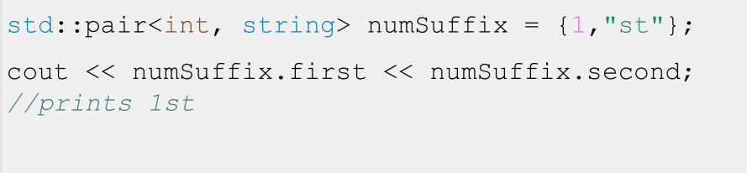
std::pair
- std::pair is a template: You specify the types of the
fields inside <> for each pair object you make
- The fields in std::pairs are named first and second

Slide 48
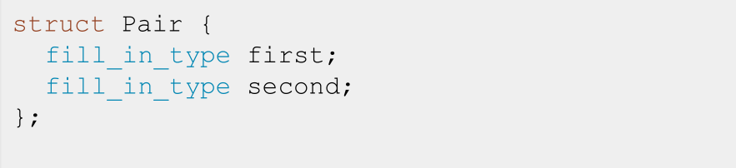
std::pair
- std::pair is a template: You specify the types of the
fields inside <> for each pair object you make
- The fields in std::pairs are named first and second

Slide 49
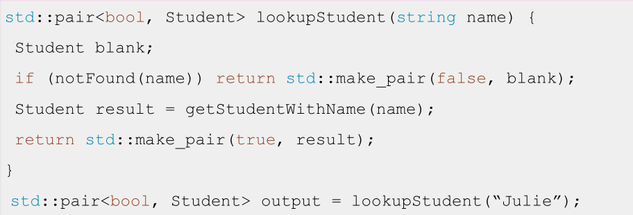
Use std::pair to return success + result

Slide 50
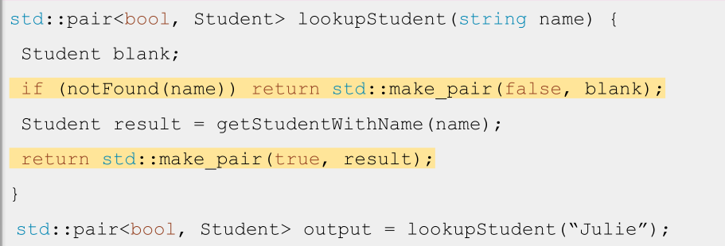
To avoid specifying the types of a pair, use
std::make_pair(field1, field2)

Slide 51
Aside: Type Deduction with auto

Slide 52
Definition
auto: Keyword used in lieu of type when declaring a variable, tells the compiler to deduce
the type.

Slide 53
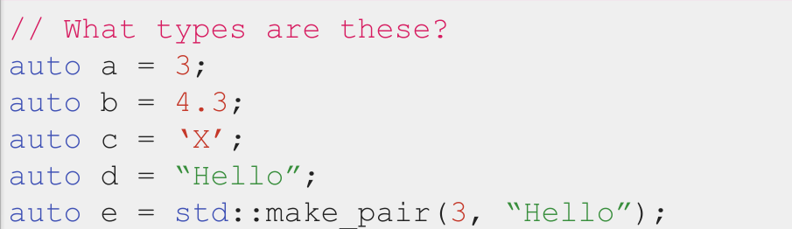
Type Deduction using auto
📝 auto does not mean that the variable doesn’t have a type.
It means that the type is deduced by the compiler.

Slide 54
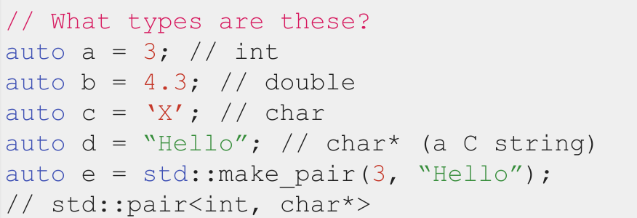
Type Deduction using auto
📝 auto does not mean that the variable doesn’t have a type.
It means that the type is deduced by the compiler.

Slide 55

auto does not mean that the variable doesn’t have a type.
It means that the type is deduced by the compiler.

Slide 56
Code Demo!
quadratic.cpp

Slide 57
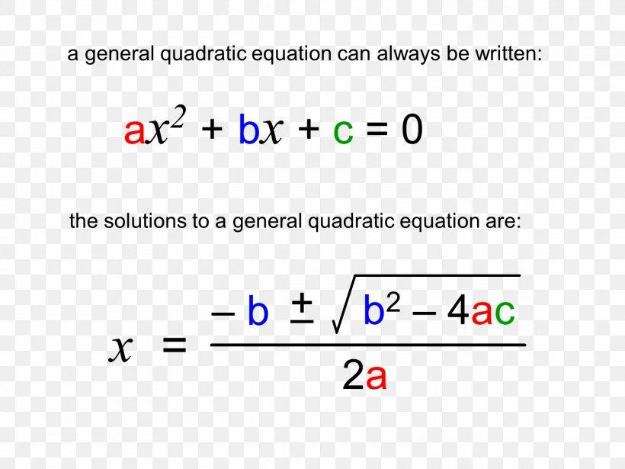
Radical
If Radical < 0, no real roots

Slide 58
Recap
- Everything with a name in your program has a type
- Strong type systems prevent errors before your code runs!
- Structs are a way to bundle a bunch of variables of many types
- std::pair is a type of struct that had been defined for you and is in the STL
- So you access it through the std:: namespace (std::pair)
- auto is a keyword that tells the compiler to deduce the type of a variable, it should be used when the type is obvious or very cumbersome to write out

Slide 59
Thank you for coming! See you Tuesday!
QiJun Zhao

